Slide 1
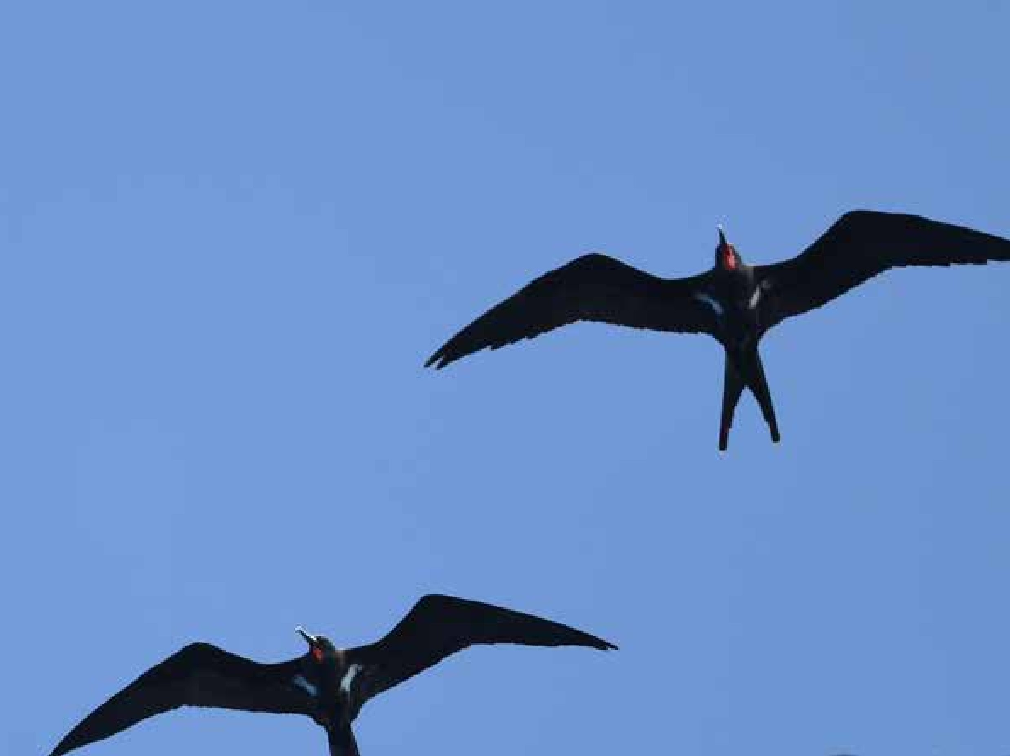
Palau Seabird Survey & Monitoring Workshop
Koror, 26-30 October 2026
Ray Pierce, Eco Oceania
Monica Gruber, Pacific Biosecurity
Etienne Delattre, SPREP
Notes:
Cover slide image: Lesser Frigatebirds, Kiribati. Hiroyuki Tanoi
This is the first slide for each day

Slide 2
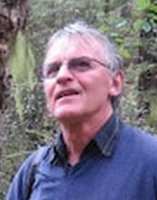

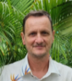
Introductions
Ray Pierce, EcoOceania
Monica Gruber, Pacific Biosecurity
Etienne Delattre, SPREP

Slide 3
Training-of-trainers Introduction
Monica Gruber

Slide 4
Objectives of the workshop
The objectives of today’s workshop are to enable participants to
Use the resources on the Seabird Surveys and Monitoring website to train others in seabird surveys and monitoring
Update Palau pages and resources on the website
The three-day workshop resources on the website demonstrate how the training could be delivered to others
Notes:
The purpose of the training-of-trainers introduction is to familiarise future trainers in seabird monitoring in Palau with the resources to support their training activities.
The resources to support the activities are found on a website.
The objectives of this training-of-trainers workshop are to enable participants to
Use the training-of-trainers resources to train others in seabird surveys and monitoring
Modify Palau pages and resources on the website
The next three days of the Palau workshop also provide a demonstration of how the training could be delivered by trainers in future events.

Slide 5
Today’s topics
The Pacific BioScapes programme
The SPREP seabird monitoring project
Pacific Seabirds Survey and Monitoring Manual
How to use the Palau workshop resources
Overview of the three-day workshop
Caution on seabird handling
How to update Palau pages on the Seabird Surveys and Monitoring website

Slide 6
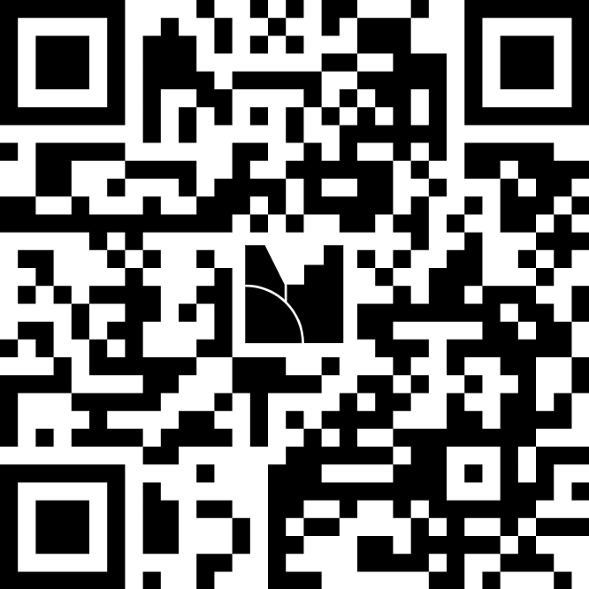
Mentimeter
Mentimeter is a way for people to share their views anonymously
We won’t know what your answers are, we only see the group results
We use Mentimeter to do some spot quizzes throughout the workshop
Let’s try it out…
Use your phone to scan this QR code

Slide 7
Mentimeter
What are your plans for the weekend?

Slide 8
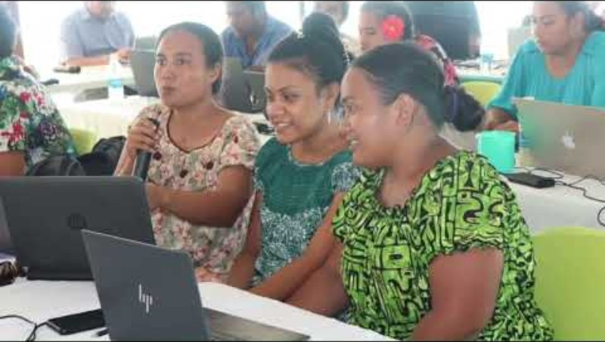
1. The Pacific BioScapes programme
Notes:
A short Youtube video that introduces the programme
https://www.youtube.com/watch?v=AU4hkzhE6PA&t=4s

Slide 9

2. The Palau seabird monitoring project
Objective
Deliver seabird monitoring training in Palau to government agencies, NGOs, CSOs, tourism operators who are either
  working on seabirds or
  have field capacity and interest
Contributes to Pacific BioScapes’ Activity 2.1.5: Increase site level management capacity of Palau’s Protected Areas Network
Notes:
The Palau seabird monitoring project is part of the Pacific BioScapes programme.
The project purpose is to deliver a seabird monitoring training in Palau for government agencies and NGOs, CSOs and tourism operators which are either working on seabirds or have field capacity and interest to do so.
The project contributes to the implementation of Pacific BioScapes’ Activity 2.1.5: Increase site level management capacity of Palau’s Protected Areas Network (PAN).

Slide 10
Pacific Seabirds Survey and Monitoring Manual
Resources and guidelines to assist seabird survey and monitoring in the Pacific region
Available on
  SPREP website https://seabirds.pacificbiosecurity.co.nz/uploads/Pacific-seabird-manual.pdf
  Website for this workshop https://seabirds.pacificbiosecurity.co.nz/
  Palau workshop resources https://seabirds.pacificbiosecurity.co.nz/index.php?page=workshop-resources
Notes:
Many of the resources that support the workshop this week are derived from the Pacific Seabirds Survey and Monitoring Manual, which was developed by SPREP for anyone in the region to use.
These are links to the pdf of the manual on the SPREP website, and the website developed for this workshop.
We will use the website for much of today’s workshop.
[skip to website] https://seabirds.pacificbiosecurity.co.nz/
The manual has five parts, as outlined in the webpage heading:
An introduction to seabirds of the Pacific;
An introduction to different types of tools for surveying;
Measurement metrics for monitoring
Managing data to support conservation
And links to some additional some resources.
There is also a link to Palau workshop resources (which has the presentations and other resources to support training in Palau), and an Acknowledgments section.
All sections that are numbered are found in the Manual itself, and sections that don’t have numbers are those that we have created for the workshop.
For example, in part 1 we have added a section on Seabirds of Palau, specially for this workshop.

Slide 11
How to use the Palau workshop resources
The Palau workshop resources section of the website has instructions on how to use the resources to deliver training
Includes
  This presentation
  Presentations and resources for the three-day workshop
Notes:
[skip to website] https://seabirds.pacificbiosecurity.co.nz/index.php?page=workshop-resources
The Palau workshop resources section of the website provides you with the materials needed to run a three-day training event on seabird monitoring.
All the materials are downloadable and editable, so you can tailor them to the needs of specific groups or if your training needs change in the future.
Use the rest of the website to find additional reference materials you might need if you want to tailor your workshop to specific needs.
You can use the search function at the top of the page to find specific items.
If there is something else that you need to deliver your training event, check the Seabirds Survey and Monitoring Manual.
You can browse through the website using the links at the bottom of each page or read specific Parts and their Sections using the links at the top of the page.

Slide 12
Overview of the three-day workshop
Day 1 covers Parts 1-3 of the Pacific Seabirds Surveying and Monitoring Manual
  Part 1: Introduction to seabirds
  Part 2: Survey tools & types
  Part 3: Measurement & monitoring
Day 2 is a practical day to practice identifying seabirds and using survey tools
Day 3 is intended to review the practical work and covers the last two parts of the Manual
  Part 4: Managing data
  Part 5: Resources
Notes:
The workshop covers all parts of the Manual at a high level.
Day 1 covers Parts 1-3 which includes
an Introduction to seabirds
Survey tools & types and
Measurement & monitoring
Day 2 is a practical day to practice identifying seabirds and using survey tools
Day 3 is intended to review the practical work and covers the last two parts of the Manual
Managing data and
Resources
Read the slide and [skip to website] https://seabirds.pacificbiosecurity.co.nz/index.php?page=workshop-resources#three-day
The workshop resources web page has an outline of the topics and timings together with supporting materials and links to the relevant sections of the Manual.

Slide 13
Workshop resources
To be added
Notes:
Download the powerpoint from https://seabirds.pacificbiosecurity.co.nz/index.php?page=workshop-resources#three-day

Slide 14
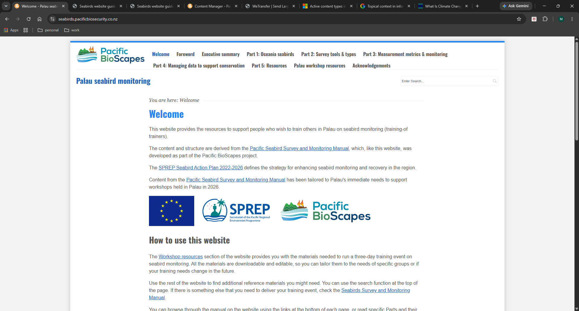
5. Exercise
Exploring the website and workshop resources

Slide 15
Instructions
To be added
Notes:
Download the powerpoint from https://seabirds.pacificbiosecurity.co.nz/index.php?page=workshop-resources#three-day

Slide 16
Caution on seabird handling
Risks
  Disrupting nesting
  Injury to seabirds
  Contracting and spreading bird flu
Handling seabirds should be avoided
Seabirds only need to be handled if they are injured or at risk of injury
Seabirds should only be handled by people who have been trained
Notes:
Although the manual discusses handling seabirds and provides instructions, this is not covered in training for several reasons.

Slide 17
How to modify Palau pages on the website
The seabirds website uses a content management system
You can modify pages on the website
  Palau workshop resources
  Seabirds of Palau (and sub-pages)
A guide has been developed that you can refer to, and this is on the website
You don’t need to know anything about developing web pages to be able to manage the content
Notes:
The resources on the website are free to use for as long as they are needed.
You can also modify certain pages on the website so they best match your needs.
[skip to website] https://seabirds.pacificbiosecurity.co.nz/index.php?page=workshop-resources

Slide 18
How to modify Palau pages on the website
To manage web pages:
  Navigate to https://seabirds.pacificbiosecurity.co.nz/admin
First I’ll create usernames for you
Username: P*****n
Password: p*****************

Slide 19
Acknowledgements
This workshop was derived from the Pacific Seabirds Survey and Monitoring Manual, which was prepared under contract (AP_2/43) between the Secretariat of the Pacific Regional Environment Programme (SPREP) and the Northern New Zealand Seabird Trust (NNZST)
The Palau workshop resources were developed by Ray Pierce (Eco Oceania) and Monica Gruber (Pacific Biosecurity), based on the resources in Pacific Seabirds Survey and Monitoring Manual, under contract (2026-PBS-001: AP_2/43) between SPREP and Pacific Biosecurity, and deployed on the website: https://seabirds.pacificbiosecurity.co.nz
The project team also acknowledges the contribution of Karen Baird, SPREP's former Threatened and Migratory Species Adviser, who led efforts to develop more seabird resources on behalf of Pacific governments, for the benefit or Pacific communities.
Contributors to the Pacific Seabirds Survey and Monitoring Manual
  Principal authors and editorial team: Chris P. Gaskin (NNZST), André F. Raine (Archipelago Research & Conservation), Kerry A. Lukies (NNZST) and Edin A. Whitehead (NNZST).
  Case study and section contributions by: Alex Wegmann, Katie Franklin, Dana Sabine, Nick Holmes (The Nature Conservancy); Peter Allen, Rohan Clarke, Karina Sorrell (Monash University); Tehani Withers (SOP Manu); Andreas Ravache (Bird Conservation New Caledonia); Nicholas Carlile (Æstrelata Restorations); Richard Griffiths, Paula Castano, Paul Jacques (Island Conservation); Megan Friesen (Wenatchee Valley College); Matt Rayner (Auckland Museum); Sara Thompson, William Sydeman (Farrallon Institute); Kathy Kuletz (U.S. Fish and Wildlife Service); Sophie Laran (La Rochelle Université – CNRS); Stephanie Borrelle and Mark O’Brien (BirdLife Pacific); Steffen Oppel (Swiss Ornithological Institute); Marc Travers (Archipelago Research & Conservation).
  Also, special thanks to Graeme Taylor, Nicholas Carlile, Jay Penniman and Steffen Oppel for reviewing the draft manuscript.
  Participants in the needs assessment review: Bird Conservation New Caledonia; Te Ipukerea Society, Cook Islands; SOP Manu – Polynesian Ornithological Society, French Polynesia; Samoa Conservation Society, Samoa; Vava’u Environmental Protection Association (VEPA), Tonga; American Bird Conservancy (ABC), ABC Marine Programme; Nicholas Carlile; Eric Vidal; Graeme Taylor; Peter Frost; Ray Pierce; Mark O’Brien; Yuna Kim; Jay Penniman; Alex Wang; Brett Mossman; Peter Vaughan; Rohan Clarke; Eric Woehler; Kazuto Kawakami; Kentaro Kazama; Steffen Oppel.
  Numerous photographers have generously contributed images; credits accompany the images.
  Cover images: White-tailed Tropicbird on nest on the island of Kaua’i, Hawaii. Photo: André F. Raine; Sooty Tern colony at Chesterfield Reef, New Caledonia. Photo: Mathieu Mathivet; ‘New Caledonian Storm-petrel’. Photo: Hadoram Shirihai; Research team on Tauturoa, Rapa, French Polynesia. Photo: Tehani Withers.
  Graphic design and layout: Carlo Iacovino.

Slide 20
Image credits
The numbers in this list refer to the figure numbers in the Pacific Seabirds Survey and Monitoring Manual. Credits for others are noted here or in the images
  Cover slide image: Lesser Frigatebirds, Kiribati. Hiroyuki Tanoi

